Slide 1

Microsoft Ignite NZ
25-28 October 2016
SKYCITY, Auckland

Slide 2
My Other Computer is an Azure Datacentre
Ivan Towlson

Slide 3
Speed matters
Timely data
Rapid feedback
Hard deadlines

Slide 4
What could you do with 100x the scale?
Do more with hyperscale
Get faster results
Run larger simulations / models
Run more projects
Explore new insights (‘what if…’)
Remove limitations
Modify more parameters
Analyse more complex models
Model larger geographic areas
Simulate longer periods of time
Generate higher fidelity results
Run more iterations

Slide 5
Big Compute
Traditional HPC (High Performance Computing)
Dedicated on-premise cluster
Cluster management/scheduling software
Microsoft implementation: Windows Server HPC Edition

Slide 6
Big Compute
HPC in the cloud
Traditional cluster management/scheduling software, running across machines in the cloud
Enables cloud burst and other hybrid scenarios
Microsoft implementation: HPC Pack

Slide 7
Big Compute
Big compute as a service
Capacity on demand
Scheduler hosted by service provider – no need for the user to run cluster manager or scheduler
Microsoft implementation: Azure Batch

Slide 8
Building a solution without Azure Batch
User application or service
Get and manage VMs
Install task applications
Significant amount of infrastructure, not related to business
Manage and authenticate users
Start the tasks
Move task input and output
Queue tasks
Task failure? Task frozen?
Scale up and down
IaaS or PaaS
Standard and custom images
Windows or Linux
PaaS
Cloud Services
IaaS
Virtual Machines
Commodity to high-performance
Small to huge
RDMA network for tightly coupled tasks
Hardware

Slide 9
Building a solution with Azure Batch
User application or service
Azure Batch
Cloud-enable applications, available as SaaS:
Don’t worry about the “plumbing”
Focus on the workload/app
Higher-level capabilities
Minimizes required Azure knowledge
App lifecycle, job dependencies, data movement, user management & authorization, quotas & budget, client plugins
VM management and job scheduling
PaaS
Cloud Services
IaaS
Virtual Machines
Hardware

Slide 10
Patterns
Parametric sweep
Monte Carlo
Divide and conquer
Map-reduce
Genetic algorithms
Search
Analytics and reporting

Slide 11
Usage patterns
Sporadic – on-demand irregular requirements
Cyclical – scheduled daily, weekly, etc.
End of period – very large runs quarterly or yearly
Project – continuing workload for duration of project
Constant – continuing business need

Slide 12
Azure Batch architecture
Jobs and tasks – work to be done
Pools and nodes – where to do that work

Slide 13
Azure Batch architecture
Windows (PaaS and IaaS)
Linux (IaaS)

Slide 14
Azure Batch architecture
Application deployment using packages
Batch Shipyard – deployment via Docker

Slide 15
Azure Batch architecture
Azure portal – admin users, operations
Command line – admin, power users
Azure XPlat CLI
PowerShell
API / libraries – developers
.NET
Java
Python
Node.js
Custom experiences – end users
Web portal
Application GUI integration

Slide 16
Demo
Batch developer experience
I’ll use .NET but other languages are similar
Batch command line admin experience
I’ll use XPlat CLI but PowerShell is similar

Slide 17
Demos
Parallelising work to finish quicker (BLAST)
Distributed deep learning (TensorFlow)

Slide 18
Challenges and lessons learned
Data movement
Inter-node communication
Critical for tightly coupled applications (MPI)
Capacity and spin-up time
Batch vs. interactive
Security boundaries

Slide 19
Ecosystem
Azure Data Factory (orchestration)
Azure Data Lake (big data)
Azure IoT (good candidate for parallel processing)
ExpressRoute (data movement, bridge to on-premise)

Slide 20
Thanks!
Compute tasks don’t have to take ages
Faster turnaround is better for business and people
Many patterns scale naturally out and/or up
More and bigger machines are there for the taking
itowlson@microsoft.com | ivan@hestia.cc
hestia.typepad.com/flatlander | @ppog_penguin
github.com/itowlson/my-other-computer

Slide 21
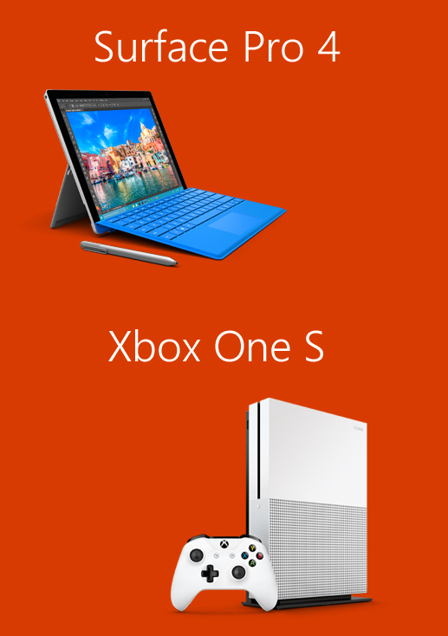
Please evaluate this session for the chance to instantly win great prizes like Surface Pro 4 and the brand new Xbox One S!
Your feedback is important to us!
From your PC or Tablet visit My Ignite at http://msignite.nz/my-ignite

